Slide 1
Module P5
Practical: Introduction to client side Javascript

Slide 2
Contents
Objective:
Learn basics of client side Javascript
Topics:
Javascript in the browser

Slide 3
Recap
Web server
github.com
Computer (host)
Network
Code update
Code update
Browser
(web client)
local machine
IMAD console
Deployment

Slide 4
Recap
Web server
nodejs code that matches a URL to a particular function.
Function can respond with text OR Function can respond with HTML

Slide 5
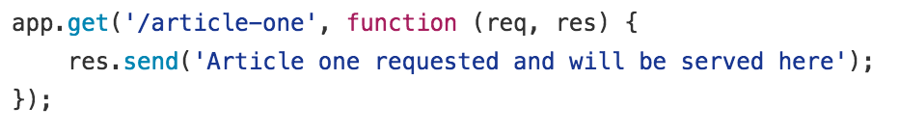
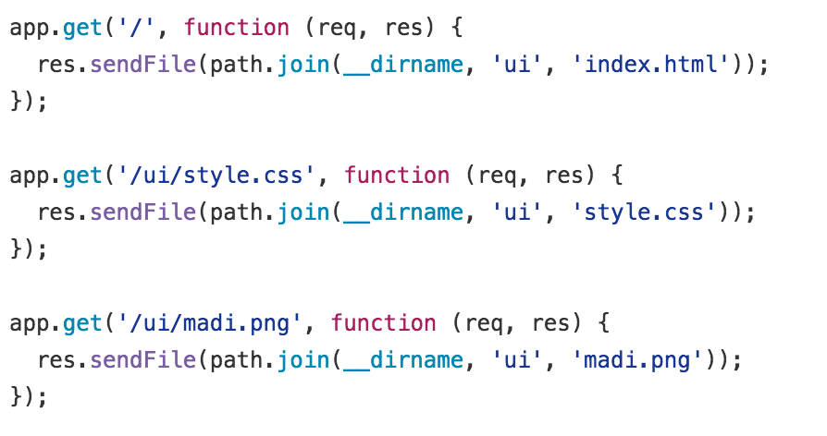
Recap
text response
html response
css response
png response

Slide 6
Client side
Browser
text response
Show text
html response
Render HTML
css response
Apply styling to current HTML document
png response
Show image

Slide 7
Client side Javascript
There is another kind of content the browser can understand: Javascript code.
If Javascript code is given to the browser, the browser can apply the Javascript for the current tab/window that contains the HTML document that has asked for the Javascript to be loaded.
There are two ways for an HTML document to ask the browser for Javascript to be loaded:
<script>
alert(‘Hi, I’m javascript’);
</script>
<script src=‘/main.js’></script>

Slide 8
Client side Javascript
Let’s write some Javascript.
Make an alert box
Output something on the console
Change the content of an HTML element
Make an element move on a click

Slide 9
Key takeaways
You send javascript source code to the browser
As inline javascript
As a file
The browser executes that source code for you in the context of that HTML document (within that browser tab) only
Javascript tools in the browser
Write javascript in the console
Making local modifications

Slide 10
Further reading
We just scratched the surface of Javascript
Read up and think of things to do and implement them in Javascript
https://www.codecademy.com/skills/make-an-interactive-website is a good course to learn JS basics

